Slide 1
Project analysis slide 2
Data 612
Final Project Presentation
Zhi Ying Chen
Sin Ying Wong
Fan Xu

Slide 2

Project analysis slide 2
Data 612 Final Project
Introduction
In this project, we are going to implement a recommender system using different algorithms for movie recommendations by using the MovieLens dataset, which can be found at [https://grouplens.org/datasets/movielens/latest/] or [http://grouplens.org/datasets/].
We will implement User-Based Collaborative Filtering (UBCF) model, Item-Based Collaborative Filtering (IBCF) model, singular value decomposition (SVD) model, alternating least square (ALS) model, and Spark ALS model to our datasets and compare their performance.

Slide 3
Project analysis slide 2
Data 612 Final Project
Note
To develop an efficient program of this project in PC environment but yet to effectively demonstrate building recommender systems using R studio, we will be covering two MovieLens datasets.
In the first section, a small MovieLens dataset of 100k+ observations will be used when building recommender systems using `Recommenderlab`.
However to meet the size requirement of data in this project, a larger MovieLens dataset with 27M+ ratings that is shrinked to around 12,000 users and 12,000 movies will be used when building a recommender system using `sparklyr` in the second section.

Slide 4
Project analysis slide 3
Data 612 Final Project
Project Flow
IMPORT DATA &
EXPLORATION
BUILD MODELS w/ RECOMMENDERLAB
COMPARE PERFORMANCES
BUILD MODEL w/ SPARKLYR
BUILD A UI w/ SHINY
Load the MovieLens datasets to our system and create our sample datasets.
Build various models with recommenderlab.
Compare model performances with ROC Curves and
RMSE metrics.
Build ALS model with sparklyr and calculate its performance.
Use shiny app to design a simple user interface.

Slide 5

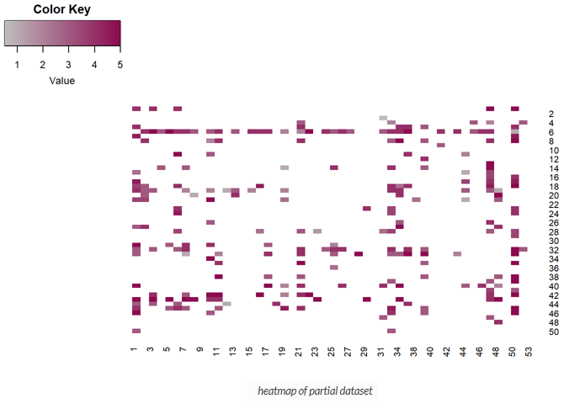
Project analysis slide 2
Data 612 Final Project
Data Exploration
The `ratings` dataset is very sparse.

Slide 6
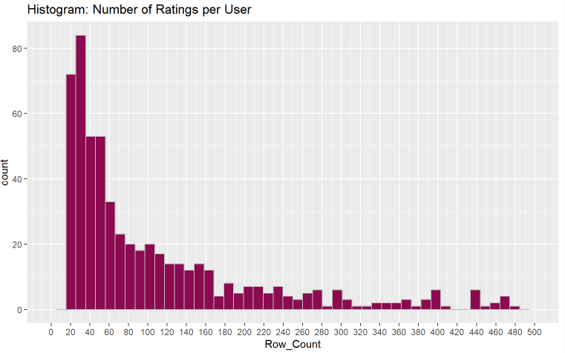
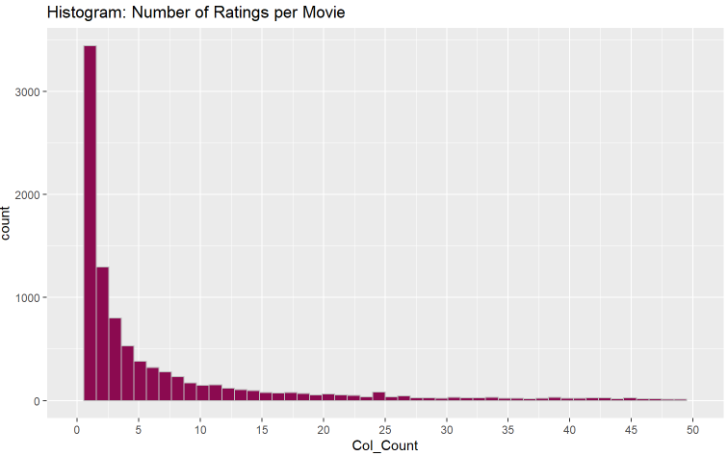
Project analysis slide 2
Data 612 Final Project
Data Exploration
Most movies are rated by no more than 5 users.
Users rated at least 20 movies.

Slide 7
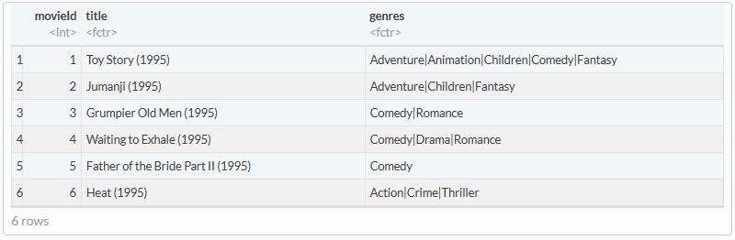
Project analysis slide 2
Data 612 Final Project
Data Exploration
The `movie` dataset contains
movie IDs,
movie titles, and
genres.

Slide 8
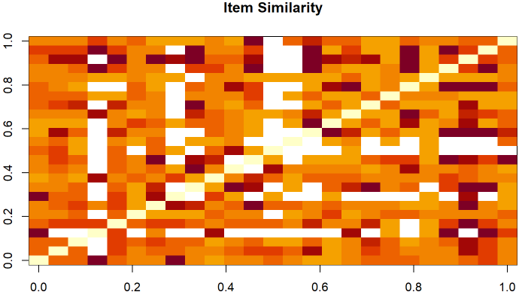
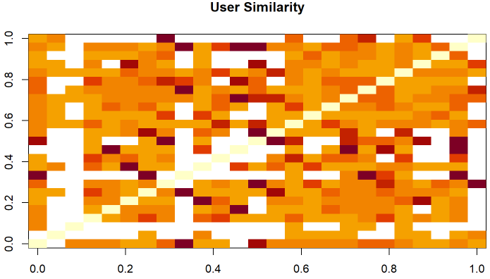
Project analysis slide 2
Data 612 Final Project
Data Exploration
User Similarity
Item Similarity

Slide 9

Project analysis slide 4
Data 612 Final Project
Building Models with RecommenderLab
ratingMatrix
(unknown data)
ratingMatrix
Recommender
Model
Predict
Top N Recommen-dations

Slide 10
Project analysis slide 2
Data 612 Final Project
Analyzing Performance
Train-Test Split
PROJECT
ALS Models
UBCF Models
SVD Models
IBCF Models

Slide 11
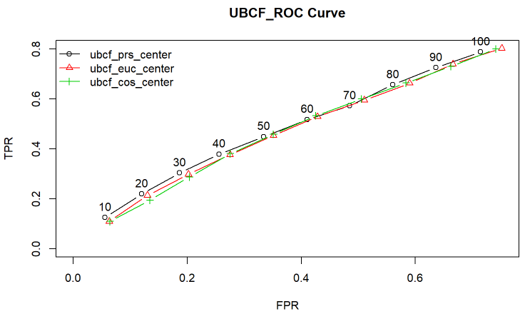
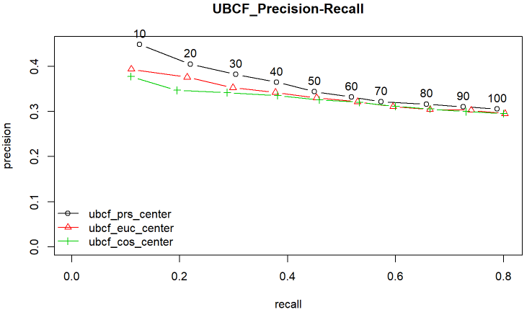
Project analysis slide 2
Data 612 Final Project
Building Models with RecommenderLab
User-Based Collaborative Filtering (UBCF)
User-Based Collaborative Filtering (UBCF) assumes that users with similar preferences will rate items similarly. Thus missing ratings for a user can be predicted by first finding a Movie of similar users and then aggregate the ratings of these users to form a prediction.

Slide 12
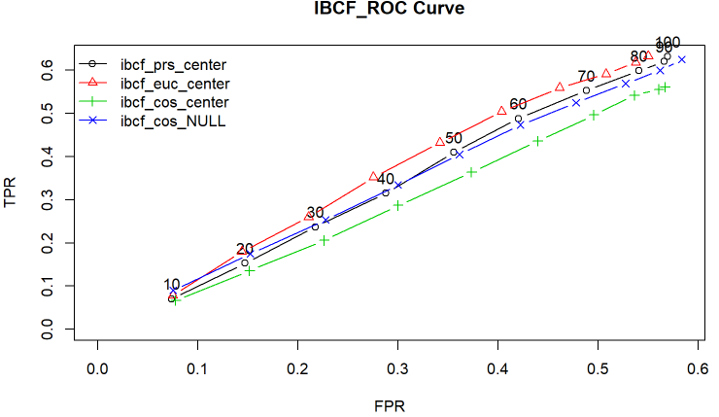
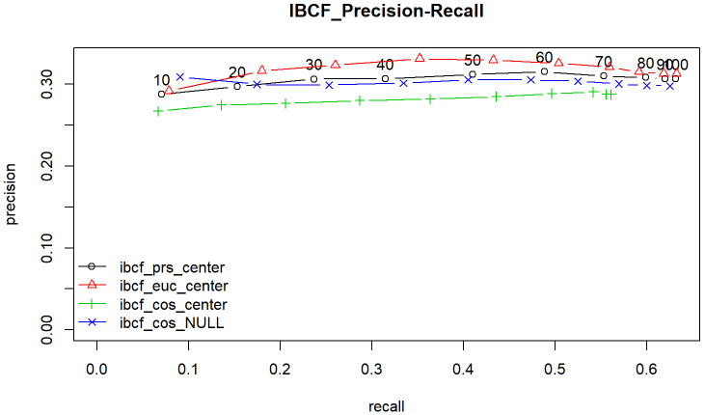
Project analysis slide 2
Data 612 Final Project
Building Models with RecommenderLab
Item-Based Collaborative Filtering (IBCF)
Item-Based Collaborative Filtering (IBCF) is a model-based approach which produces recommendations based on the relationship between items inferred from the rating matrix.
The assumption behind this approach is that users will prefer items that are similar to other items they like. The model-building step consists of calculating a similarity matrix containing all item-to-item similarities using a given similarity measure. Popular measures are Pearson correlation and Cosine similarity, which we have applied to our models.

Slide 13
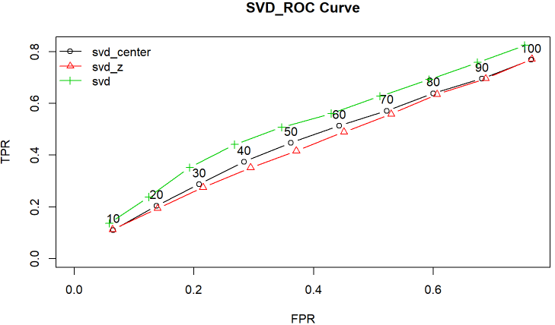
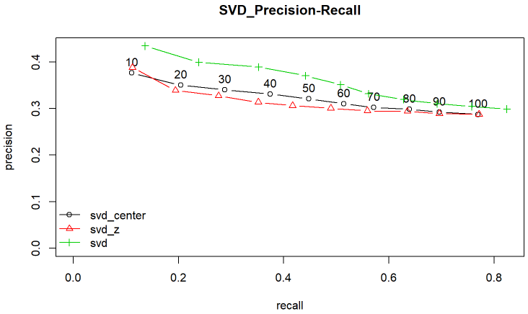
Project analysis slide 2
Data 612 Final Project
Building Models with RecommenderLab
Singular Value Decomposition (SVD)
Singular Value Decomposition (SVD) is a matrix factorization technique, which reduces the number of features of a dataset by reducing the space dimension from N-dimension to K-dimension (where K<N). In the context of the recommender system, the SVD is used as a collaborative filtering technique.

Slide 14
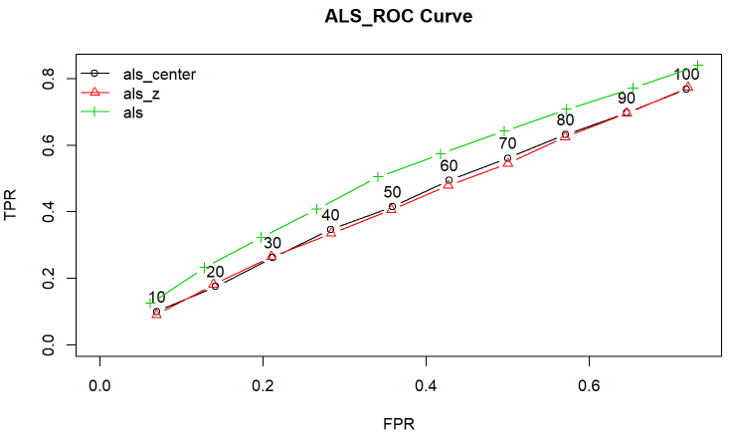
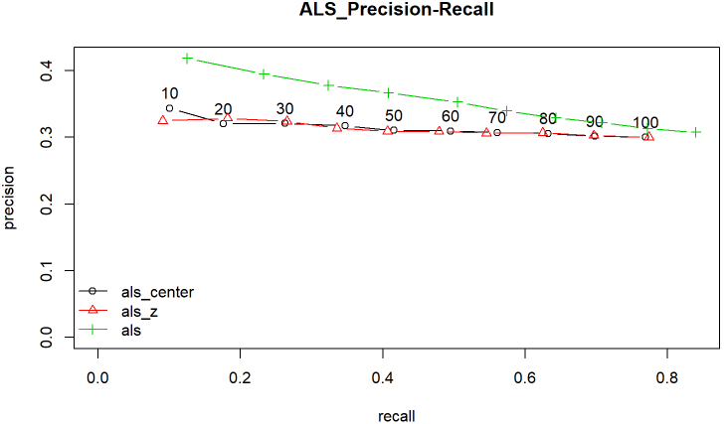
Project analysis slide 2
Data 612 Final Project
Building Models with RecommenderLab
Alternating Least Squares(ALS)
ALS recommender is a matrix factorization algorithm that uses Alternating Least Squares with Weighted-Lamda-Regularization (ALS-WR). It factors the user to item matrix A into the user-to-feature matrix U and the item-to-feature matrix M.

Slide 15
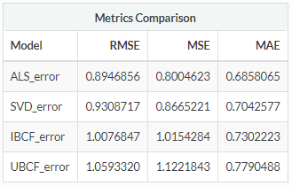
Project analysis slide 2
Data 612 Final Project
Analyzing Performance
Accuracy Metrics
By comparing the accuracy of the best model among all algorithms, we have the non-normalized ALS model as the best model.

Slide 16
Project analysis slide 4
Data 612 Final Project
Building Recommender System in Spark
R Studio
dplyr
(Included in tidyverse)
Apache Spark
Data Frame
(eg. Ratings, Movies)
Sparklyr
ML
(eg. Finction: ml_als)
Extensions
(eg. rsparkling)

Slide 17
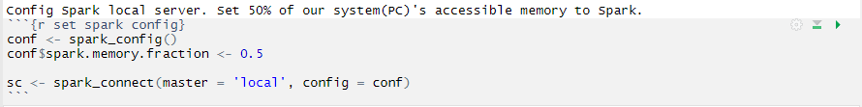
Project analysis slide 4
Data 612 Final Project
Building Recommender System in Spark
Create Local Spark Connection
● spark_config()
● spark_ connect(master, config)
Copy Data to Spark
● sdf_copy_to()

Slide 18
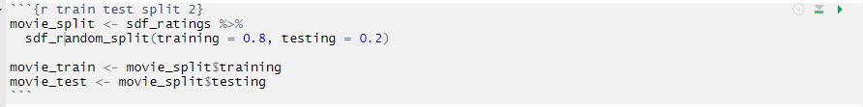
Project analysis slide 4
Data 612 Final Project
Building Recommender System in Spark
Train-Test-Split
● sdf_random_split()
Train Model
● ml_als()
Make Prediction
● ml_predict()

Slide 19
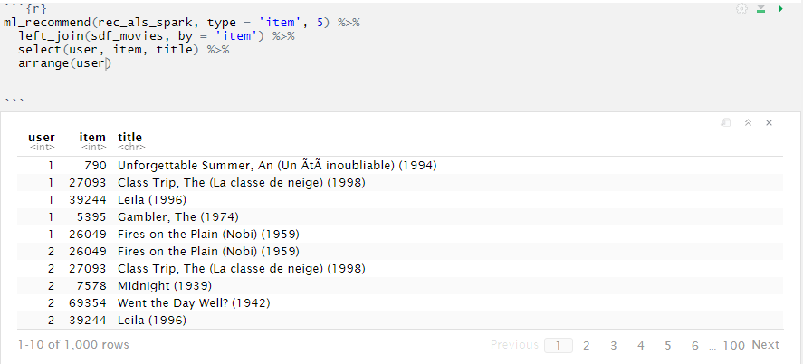
Project analysis slide 4
Data 612 Final Project
Building Recommender System in Spark
Make Top N Recommendation
● ml_recommend()

Slide 20
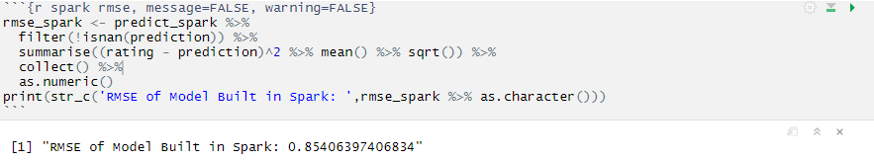
Project analysis slide 4
Data 612 Final Project
Building Recommender System in Spark
Calculate RMSE

Slide 21

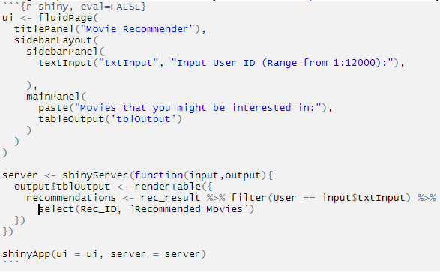
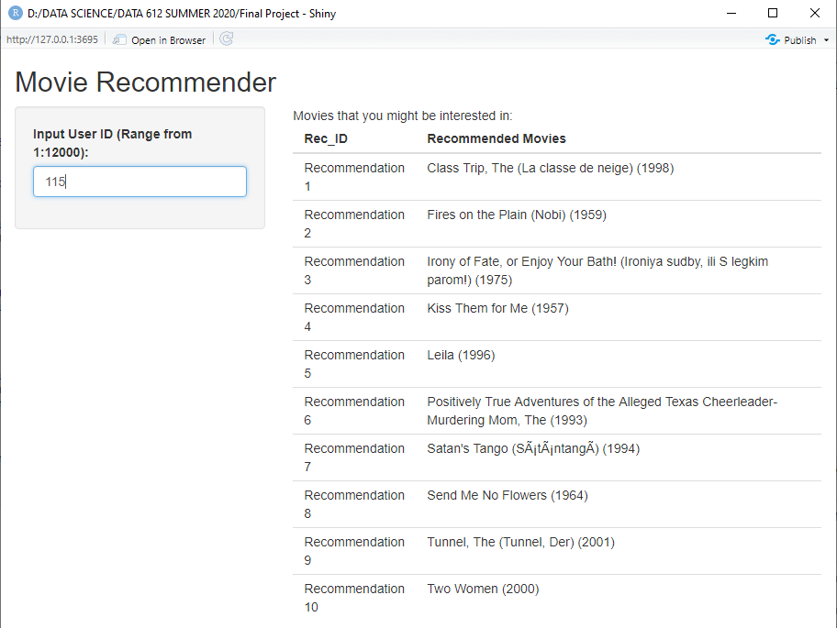
Project analysis slide 4
Data 612 Final Project
Building User Interface
with Shiny

Slide 22

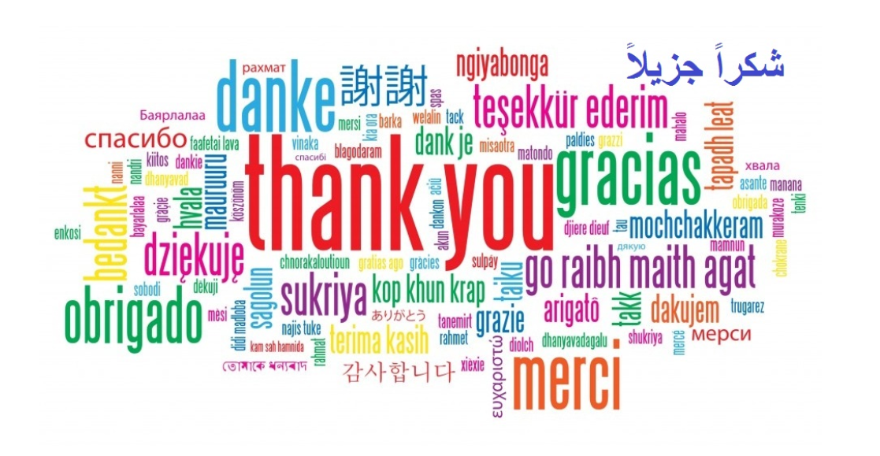

Slide 23
Thank You

